Slide 1

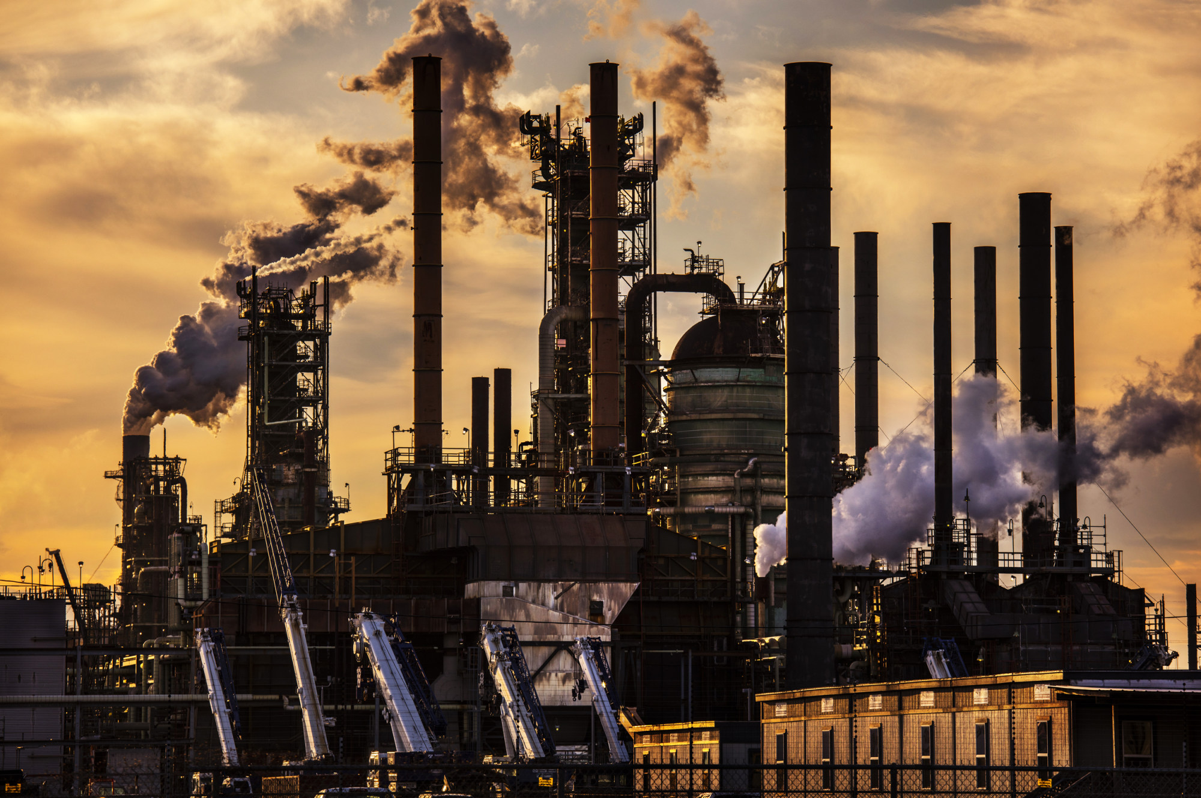


2020 – 2030
EPOXY RESIN
MARKET
FORECAST & OPPORTUNITIES
Prepared for :
MARKET INTELLIGENCE . CONSULTING
www.techsciresearch.com

Slide 2
Strategic Recommendations
Product Name | Demand Supply Gap -2025 | Demand Supply Gap -2030 | Export Potential | Backward Integration | Forward Integration | Recommendations
Bisphenol A Liquid Epoxy Resin | High | High | Yes | No | Yes (Specialized Epoxy Resin & VER) | Project can be planned by 2024 and 2028 in two phases
Bisphenol A Solid Epoxy Resin | Medium | High | Yes | No | Yes | Project can be planned by 2024 and 2028 in two phases
Bisphenol F Liquid Epoxy Resin | Low | Medium | Yes | No | Yes(Specialized Epoxy Resin & VER) | Project can be planned by 2024 and 2028 in two phases
Semi Solid Bisphenol A Epoxy Resin | Medium | Medium | Yes | No | No | Project can be planned by 2024 and 2028 in two phases
Cresol Novolac Epoxy Resin | Low | Medium | Yes | No | No | Project can be planned by 2024 and 2028 in two phases
Phenol/Modified Novolac Epoxy Resin | Medium | High | Yes | No | Yes (VER) | Project can be planned by 2024 and 2028 in two phases
Cycloaliphatic Epoxy Resin | Low | Low | Yes | No | No | Project can be planned by 2024 and 2028 in two phases

Slide 3

Key Insights : Epoxy Resin
Expected Growth Epoxy Resin
Demand Drivers – Epoxy Resin
increasing population & per capita income in developing countries like China & India (are boosting the automotive and aviation industry production)
Infrastructure development (Paints, coatings, building, and construction etc.)
Energy efficient technologies eg (Wind turbine blade & transportation industry to increase the fuel efficiency via revolutionary advancements in weight)
adhesive and moisture-resistant properties (as coatings and as waterproofing in many industries, including home construction.)
Increase usage in Electrical, Electronic & IT industries (e.g. electrical insulators, Internal printed circuit board, LED’s, solar panel & many other devices)
The principal uses of epoxy resin in aircraft, wind turbine blades, sporting goods, pressure vessels, and automotive. These superstrong, lightweight epoxies composites are used to make part of the structure of Boeing 787 Dreamliners and Airbus A350 models, as well as other aircraft. Use in offshore wind turbine blades is expected to grow by approx 10% or more in the next few years.
The pressure vessel market is expanding as a result of greater use of compressed natural gas for vehicles. In automotive, BMW currently uses epoxy for some parts used in its 3 and 7 series models, and adoption by other brands is expected in the near future.
Adhesives, which are being used in greater quantities in automotive assembly operations to bond dissimilar materials of construction (such as steel, plastics, and aluminum), which are difficult to bond with mechanical fasteners.
South Korea is the second-largest shipbuilder in recent years, surpassed only by mainland China. Only moderate growth is expected in the near future because of increased competition with Chinese shipyards. Total epoxy resin consumption for coatings is therefore projected to grow at only 2–3% annually for the next five years.

Slide 4
Challenges During the forecast period
Cost Escalation: Epoxy Market is driven by the raw material price & its availability. There has been seen large price changes of BPA & ECH (Bisphenol A & Epichlorohydrin respectively) during covid 19, which ultimately affect the epoxy resin price & its demand. The fluctuating commodity prices may also impact total project cost.
1
BPA is a suspected endocrine disrupter. As a result, most manufacturers of canned food are switching to non-BPA linings, and some have established timetables for replacement with more acceptable substitutes.
2
The quantities of solventborne (where solvents are carrier agents in some types of epoxies) epoxy coatings produced globally on an annual basis emit globally significant amounts of solvents such as xylenes, ketones, and alcohols. In China, the cargo container industry has voluntarily agreed to Boycott the use of solventborne coatings.
3
Most epoxy surface coatings tend to chalk or discolour upon exposure to sunlight, so they are seldom used for architectural surfaces that are exposed to outdoor light.
4
5
Surplus Capacity in some region will result in undershoot in selling price
6
The specialty epoxies business is currently the more attractive portion of the industry since there are higher barriers to entry and requirements, like formulating skills and technical support which needs to be constantly monitored by the manufacturer which otherwise can cause operating inefficiencies or inconsistent quality of the product

Slide 5


Recommendations for setting up facility for production of considering the return of investments and economical scale
Suggested Product Mix Capacity
Viewing the growth scenario of epoxy in diverse application, Suggested capacity is 84 KTPA, which is to be implemented in two phases: 1st Phase - 2024 and 2nd Phase -2028.
Regarding Market distribution, in 1st phase of operation, certain volume of the total liquid and novolac epoxy resin manufactured can be used as raw material for the Vinyl ester resin. Superior grades of formulated epoxy resins can be exported to Europe, Northeast Asia and North America.
RIL being the global renouned company known for its superior quality services & product have ability to put his footprints in the Epoxy resin market along with other global players like Huntsman, Olin corporation, Grasim ltd. , Atul Ltd. Kukdo chemicals etc.
Suggested Capacity |  | 2024 | 2028 (Additional Capacity)
Value in Tonnes
1. Liquid Epoxy Resin | Product Specifications
Bisphenol A (80%) | Unmodified with EEW range 172-204 | 22,000 | 22,000
Bisphenol F and S (20%)
2. Semi-Solid BP-A based Resins | EEW range 240-720 | 3,000 | 3,000
3. Solid Epoxy Resin |  | 10,000 | 10,000
4. Specialized Epoxy Resin | Multifunctional (Novolac Epoxy Resin, Phenol / Cresol), Cycloalipahtic | 6,500 | 6,500
5. Others | Dimer Acid Modified Epoxy Resins, Brominated Epoxy Resins, Glycidyl amine Epoxy Resins others) | 500 | 500
Total(1+2+3+4+5) |  | 42,000 | 42,000
Epoxy System Plant Capacity*
Formumated Epoxy Resin |  | 10,000 | 10,000
Hardeners |  | 5,000 | 5000
Reactive diluents |  | 3,000 | 3000
Total Epoxy Resin and System |  | 60,000 | 60,000
Source: TechSci Research

Slide 6
Observation in the project cost, viability and sensitivity on fluctuation in feedstock and product price
The specialty epoxies business is highly competitive & currently the more attractive portion of the industry, which require exclusive R&D facilities & manufacturing facilities (i.e., depend on process parameter).
Epoxy Resin market price is driven directly with raw material availability & its price fluctuation. Relative sensitivity, in decreasing order is
Selling Price (i.e., Revenue)
Feedstock Prices (i.e., Raw Material Costs)
Investment (i.e., Capital Cost)
NPV in USD Million
 | BASE CASE | 90.00% | 95.00% | 105.00% | 110.00%
 | CAPITAL COST
IRR% | 73.00% | 72.48% | 72.74% | 73.26% | 73.53%
NPV | 219.36 | 217.89 | 218.63 | 220.10 | 220.83
Payback Period | 1.77 | 1.78 | 1.78 | 1.76 | 1.75
 | REVENUE
IRR% | 73.00% | 54.54% | 63.99% | 81.71% | 90.22%
NPV | 219.36 | 139.04 | 179.2 | 259.52 | 299.68
Payback Period | 1.77 | 2.35 | 2.02 | 1.58 | 1.43
 | RAW MATERIALS COST
IRR% | 73.00% | 83.21% | 78.14% | 67.78% | 62.45%
NPV | 219.36 | 265.46 | 242.41 | 196.31 | 173.26
Payback Period | 1.77 | 1.55 | 1.65 | 1.91 | 2.07
Source: TechSci Research

Slide 7
Recommendations for setting up facilities for production of epoxyResin considering the returns of investments and economic of scale (2/2)
Name of the Product (KTPA) | 2023 | 2027 | Total
Unsaturated Polyester Resin | 42 | 42 | 50
Note:- Above tabular data breakdown is based as per proposed weightage of planned production as per analyst inferences:
Phase-1 i.e. in 2024 will incur approximately 65% of the total CAPEX which includes Electrical Supply Installation & Commissioning, Instrumentation and Process Equipment, Mechanical Structure & Piping
Phase-2 i.e. 2028 will incur remaining share of CAPEX based on repeat scope of Phase-1 components.
Civil work costs will be undertaken during Phase-1 initiation (95% of overall cost) and Phase-2 initiation (5% remaining share of overall cost)

Slide 8
















Representative list of clients

Slide 9

About Us & Disclaimer
TechSci Research is a global market research and consulting company with offices in the US, UK and India. TechSci Research provides market research reports in number of areas to organizations. The company uses innovative business models that focus on improving productivity, while ensuring creation of high-quality reports. The proprietary forecasting models use various analyses of both industry-specific and macroeconomic variables on a state-by-state basis to produce a unique ‘bottom-up’ model of a country, regional and global industry prospects. Combined with the detailed analysis of company activity and industry trends, the result is a uniquely rich evaluation of the opportunities available in the market.
Related Reports
Global HBPA Epoxy Resin Market By Physical Form (Solid and Liquid), By Application (Industrial Coating, E&E Coating and Others), Competition, Forecast & Opportunities, 2026
Global Composites Market By Type (Glass Fiber & Carbon Fiber), By Application (Civil Engineering, Aerospace & Défense, & Others), By Manufacturing Process (Lay Up, Injection Moulding, etc.), By Region, Competition Forecast & Opportunities, 2012-2026
TechSci Research – North America
708 Third Avenue, Manhattan,
New York, United States
Tel: +1- 646- 360- 1656
Email: sales@techsciresearch.com www.techsciresearch.com
TechSci Research – Europe
54, Old brook, Bretton,
Peterborough,
United Kingdom
Email: sales@techsciresearch.com www.techsciresearch.com
TechSci Research – Asia-Pacific
B – 44, Sector – 57, Noida, National Capital Region, U.P. - India
Tel: +91-120-4523900
Email: sales@techsciresearch.com www.techsciresearch.com
Disclaimer
The contents of this report are based on information generally available to the public from sources believed to be reliable. No representation is made that it is timely, accurate or complete. TechSci Research has taken due care and caution in compilation of data as this has been obtained from various sources including which it considers reliable and first hand. However, TechSci Research does not guarantee the accuracy, adequacy or completeness of any information and it is not responsible for any errors or omissions or for the results obtained from the use of such information and especially states that it has no financial liability whatsoever to the subscribers / users of this report. The information herein, together with all estimates and forecasts, can change without notice. All the figures provided in this document are indicative of relative market size and are strictly for client’s internal consumption. Usage of the same for purpose other than internal will require prior approval of TechSci Research.

